Slide 1
Laravel Middleware

Slide 2
Middleware acts as a layer between the user and the request. It means that when the user requests the server then the request will pass through the middleware, and then the middleware verifies whether the request is authenticated or not. If the user's request is authenticated then the request is sent to the backend. If the user request is not authenticated, then the middleware will redirect the user to the login screen.
An additional middleware can be used to perform a variety of tasks except for authentication. For example, CORS middleware is responsible for adding headers to all the responses.
Laravel framework includes several middleware such as authentication and CSRF protection, and all these are located in the app/Http/Middleware directory.

Slide 3
We can say that middleware is an http request filter where you can check the conditions.

Slide 4
Make a middleware
Apply middleware
Check condition in middleware
Route middleware

Slide 5
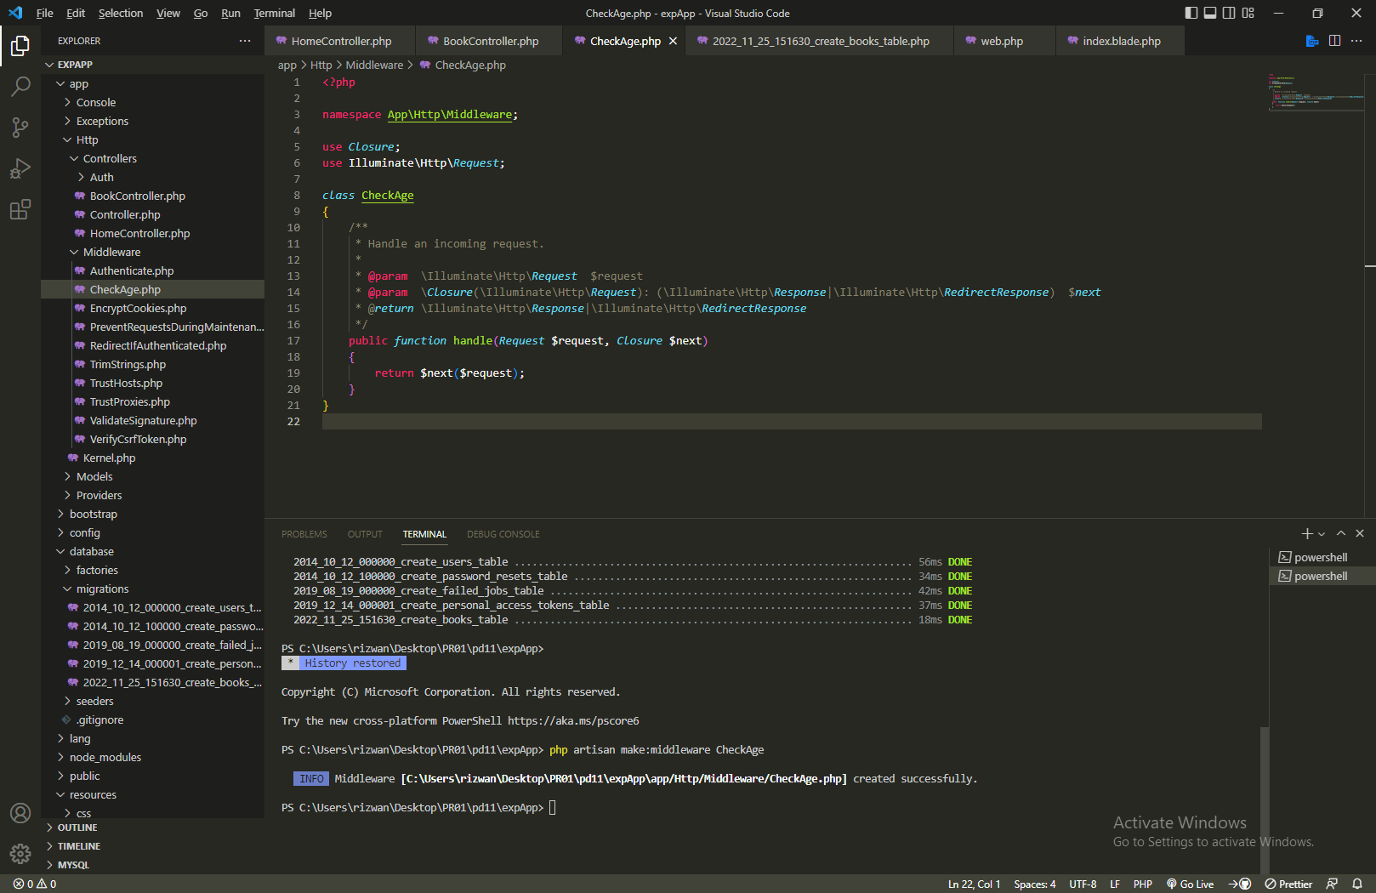
Creating a middleware

Slide 6
Apply a Middleware
Middleware can be either applied to all the URLs or some particular URLs.
Middleware can be either applied to all the URLs or some particular URLs.
Step 1: Open the kernel.php file. If we want to apply the middleware to all the URLs, then add the path of the middleware in the array of middleware.
Step 2: Type the command php artisan serve in Git Bash Window.
Step 3: Open the CheckAge.php file, which you have created as a middleware.
Step 4: Now, enter the URL 'http://localhost/laravelproject/public/'.

Slide 7
Let's apply the middleware to some specific routes.
Step 1: Open the kernel.php file. If we want to apply the middleware to some specific routes
Step 2: Open the CheckAge.php file, which you have created as a middleware.
Step 3: Add the middleware code in the web.php file.

